Slide 1

Chapter 2 & 3
Basic R Operations and Concepts
&
Data Description
(IPSUR)
Matthew Wayne Valentine
Office 1.32
Lab K2 – Tech Room K2
mvalentine@uwc.ac.za

Slide 2
Chapter 2
Basic R Operations and Concepts

Slide 3


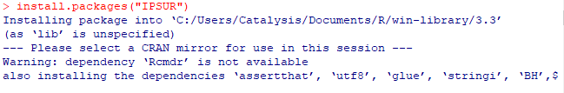
Loading Packages
There are default packages and datasets that are loaded automatically with R.
Use the library() option to check default packages.
To attach another package to your workspace, either use the command install.packages (“PACKAGENAME”, DEPENDS=) ,
Or a package can be loaded by use the “Packages” toolbar.
We need to load the package “IPSUR”
To install the package in R; in the R console type “ install.packages(“IPSUR”)” NB: R is case-sensitive
Notes:
The MD5 hash functions as a compact digital fingerprint of a file.
Depend, are files that are used with other packages such as creating specific graphs or calculations that are needed for other packages.

Slide 4
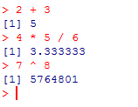
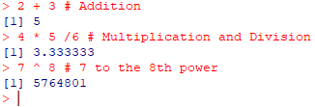
Basic R Operations and Concepts
Arithmetic
These are basic calculations that can be performed in R by hard coding it.
Within the R console Type the following;
Use the comment character (# ) to add comments to the code.
1.
1.
2.
2.
3.
3.

Slide 5
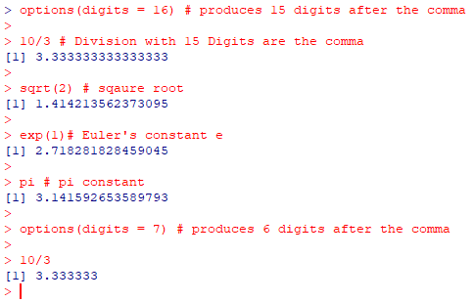
Arithmetic Continued…
These are basic calculations that can be performed in R by hard coding it with a # to provide comments of the basic calculation performed

Slide 6
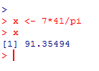
Assignment, Object Names and Data Types
There is a convenient way to assign numbers and values to variables in order to be used later.
In order to assign values to a variable is with the “<-” operator, one can also use an “=“ sign but it’s recommended to use the “<-” operator.
The value can thus be recalled later if need be.
When choosing a variable name to represent values to variables.
Examples of valid names are as follows;
x, x1, y.value or y_hat

Slide 7
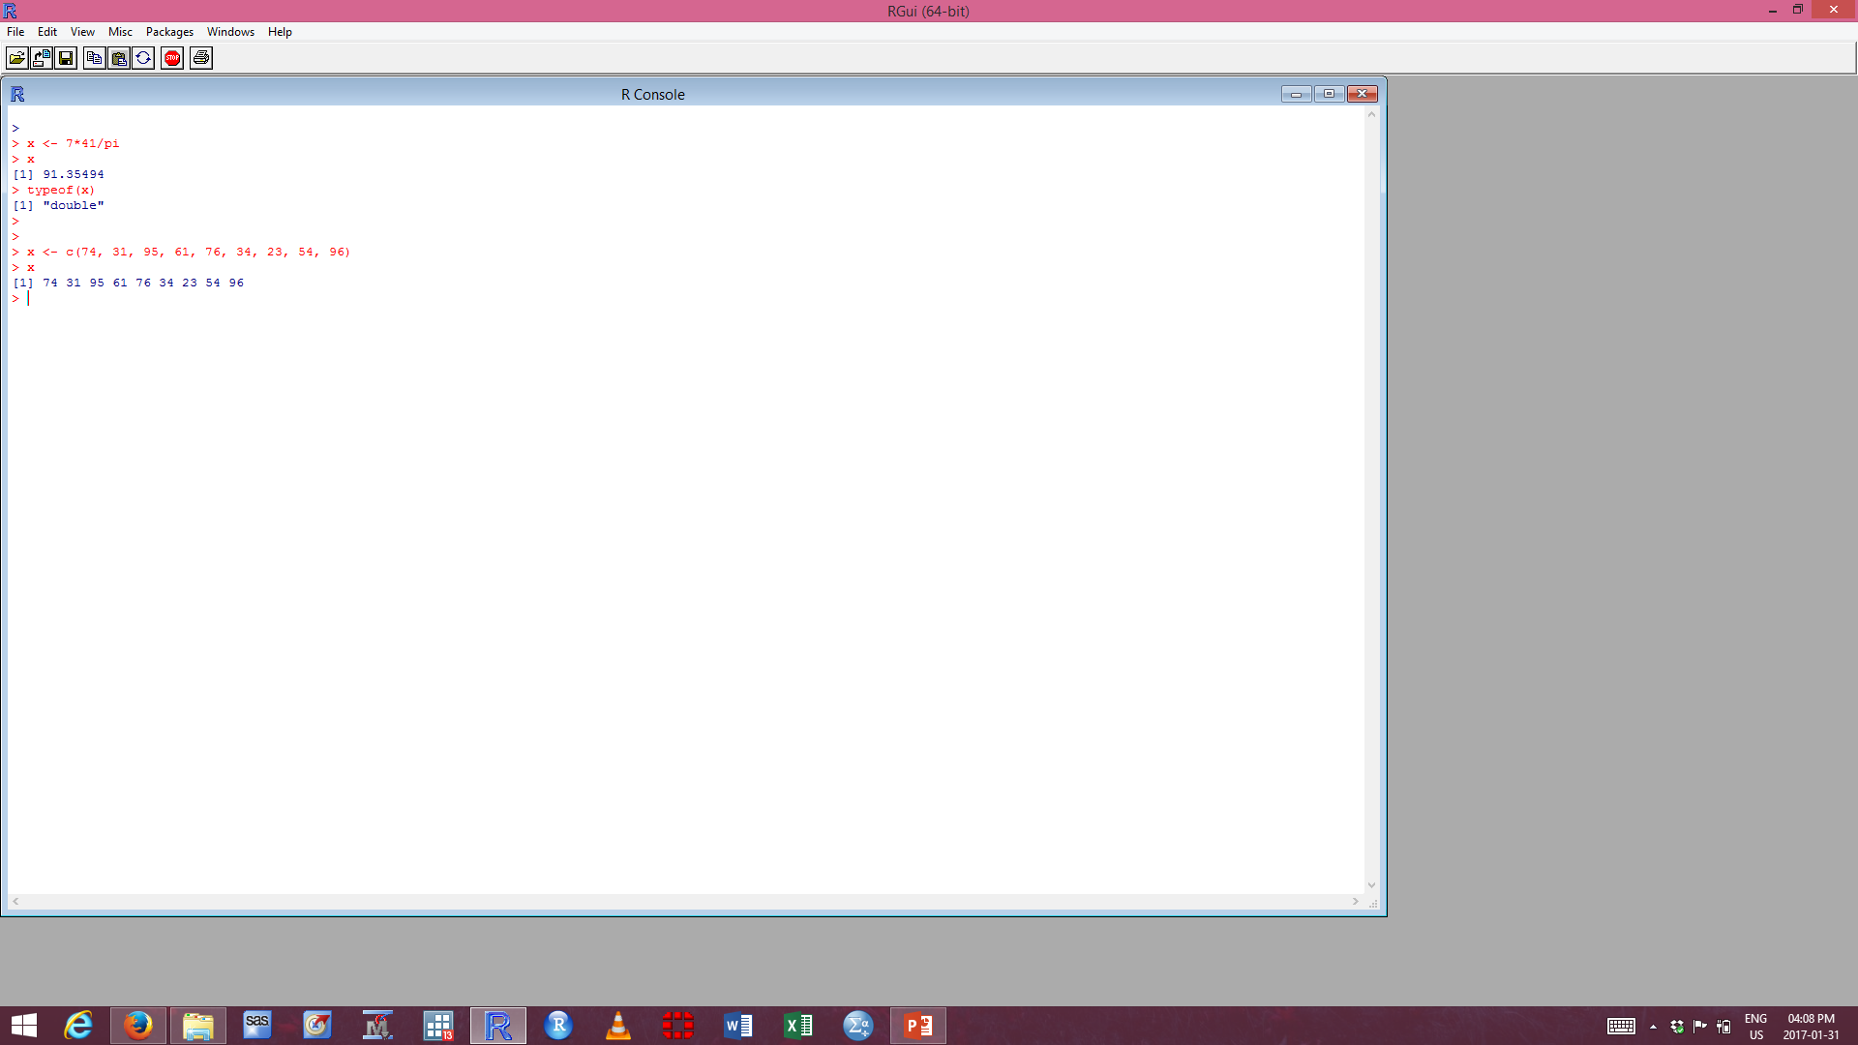

Vectors – Entering Data Vectors
Creating a data vector, one will use the c function which is placed before the first parentheses. The c function is short for Concatenate.
The scan() function is useful when you have data stored somewhere else. Note; when entering an empty line, the scan will stop and if you have a spreadsheet of data; you may enter all in line “1:” and it will sequentially add the next value to the next display point.
Once you get to the 6th entry, all you have to do is press enter and R will understand that you want to read in 5 items or observations.

Slide 8

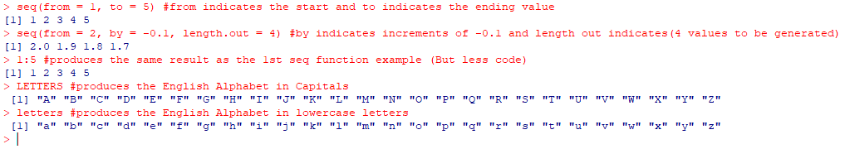
Vectors - Entering Data Vectors Cont.
The seq function allows one to generate a sequence of numbers or values. Within the seq function there are different types of arguments such as from, to, by and length.out.

Slide 9
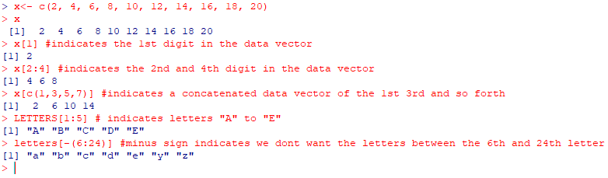
Vectors – Indexing data vectors
Indexing can be used to retrieve certain values from a data vector.
A pre-existing data vector can be used if it was assigned an object name. Otherwise in order to use indexing a vector needs to be created.

Slide 10
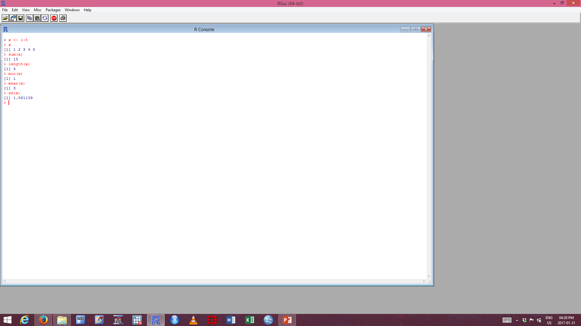
Vectors – Functions and Expressions
These functions takes arguments as inputs and returns an object as an output. Below are a few basic summary statistics; such as the min, mean and standard deviation.
If there are specific functions that you would like to see how its been calculated; one can do so by entering the function without parentheses or arguments. Example; type what's in the “ ”. “mean” or “sd”

Slide 11
Chapter 3
Data Description

Slide 12
Types of Data - Quantitative
Quantitative data are any data that measure or are associated with a measurement of the quantity of something. Eg; Numerical Values
Quantitative data are sub-divided into two categories namely; Discrete and Continuous data.
Discrete Data – takes on values in a finite or countably infinite set of numbers; Eg; 1,2,3, etc…
Continuous Data – takes on values in an interval of numbers. These are also known as measurement, scale or interval data. Eg; Height, Weight, Length or Time.
Example 3.1: Annual Precipitation in US Cities

Slide 13

Types of Data - Quantitative
The output shows that precip is a numeric vector which has been named.
Named num [1:70] – indicates that there are 70 observations with with each city provided with an attributed name.
precip[1:4] – indicates that we would like to see only the first 4 Cities precip values that are in the data vector. These values are continuous in nature.
If you want to see the whole data vector; type “>precip” and it will display the entire data vector.
Example 3.1: Annual Precipitation in US Cities
Notes:
Example 3.1. Annual Precipitation in US Cities. The vector precip contains average amount
of rainfall (in inches) for each of 70 cities in the United States and Puerto Rico. Let us take a look
at the data:

Slide 14
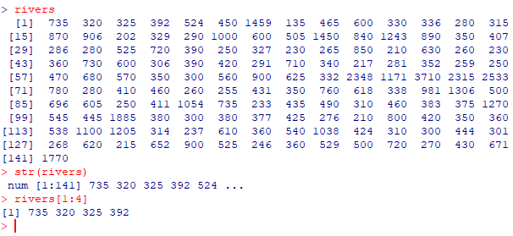
Types of Data – Quantitative cont.
The output shows that rivers is a numeric vector which has been not been named.
str(rivers) – indicates that there are 141 lengths of rivers that were recorded for this specific data vector of American rivers. This type of data is discrete in nature. But for statistical purposes it’s continuous in nature.
Example 3.2: Lengths of Major North American Rivers
Notes:
Example 3.2. Lengths of Major North American Rivers. The U.S. Geological Survey recorded
the lengths (in miles) of several rivers in North America. They are stored in the vector rivers in
the datasets package (which ships with base R). See ?rivers. Let us take a look at the data with
the str function.

Slide 15
Displaying - Quantitative Data
When confronted with Quantitative data, one needs to make some sort of visualization of the data in order to gain insight into the data structure.
These are some ways in which one can describe data.
Strip charts (Also known as Dot Plots) – Can be used for discrete or continuous data. Along the horizontal axis is a numerical scale above which the data values are plotted. This can be done using the stripchart function.
These are the methods that can be used as displays;
overplot – plots ties covering each other. We use it to display distinct values within a dataset.
jitter – adds some noise to the data in the y direction in which case the data values are not covered up by ties.
stack – plots repeated values stacked on top of one another, used for discrete data.

Slide 16
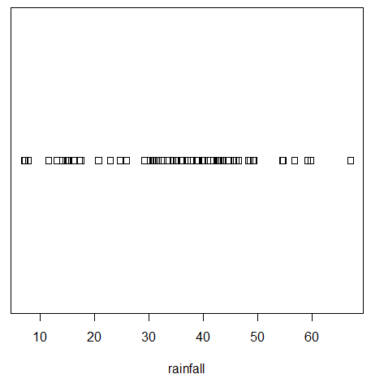
Displaying - Overplot
Example 3.1: Annual Precipitation in US Cities

Slide 17
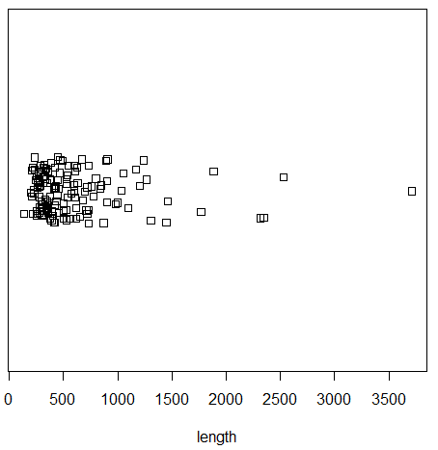
Displaying - Jitter
Example 3.2: Lengths of Major North American Rivers

Slide 18
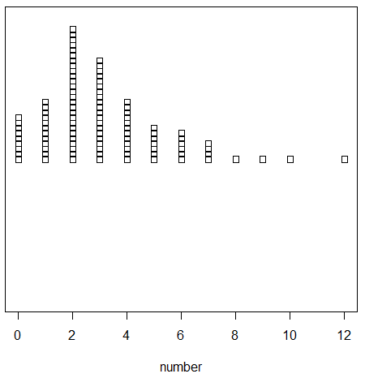
Displaying - Stack
Example 3.1: Yearly Numbers of Important Discoveries

Slide 19
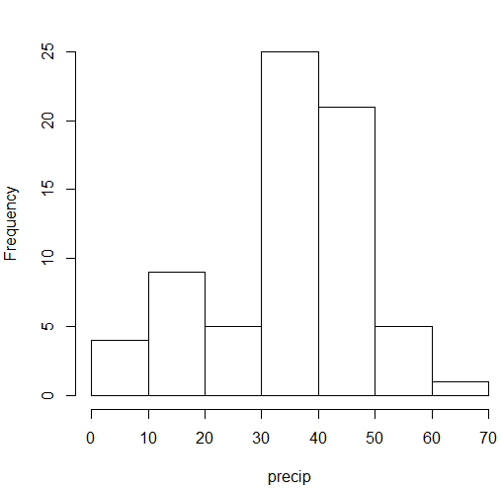

Displaying - Histogram
Histograms are typically used for continuous data. Use the function hist() to display a histogram. We would like to investigate the nature of the datasets distribution for the Precipitation of rainfall for the US Cities.
Main = “” argument supresses the main title from being displayed. It would have said “Histogram of precip”.
The data is skewed to the right.
In order to investigate the histogram further, the default bins should be changed to gain further insight into the dataset’s distribution.

Slide 20
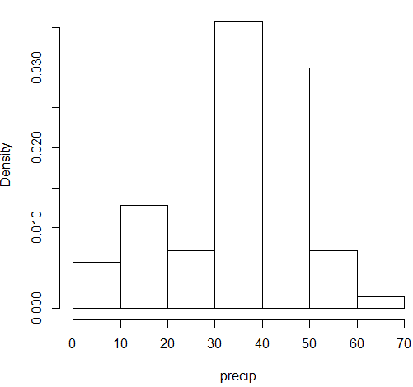
Displaying – Histogram cont.
Freq = FALSE – indicates that one would like to display a relative frequency plot

Slide 21


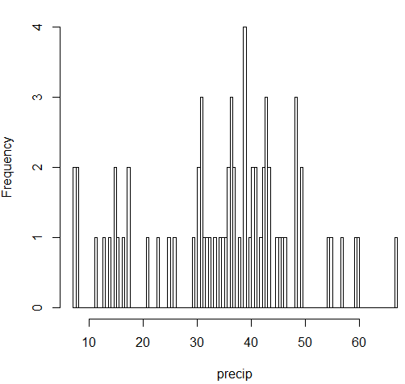
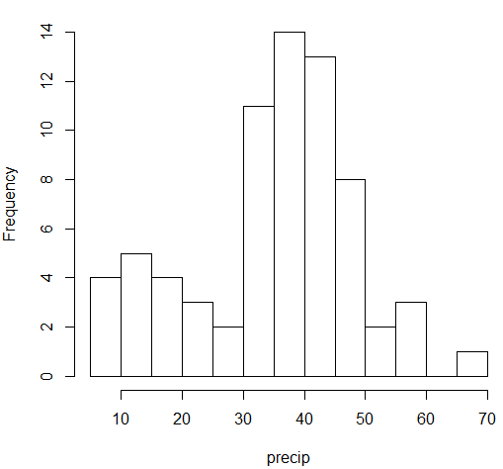
Displaying – Histogram (Changing Bins)

Slide 22
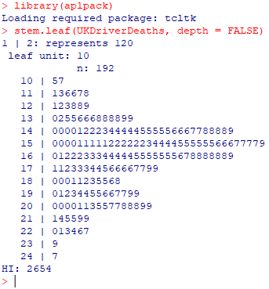
Displaying – Stemplot
Stem and Leaf plots have to basic parts namely; Stem and Leaves.
The final digit of the data values is taken to be a leaf , and the leading digits is taken to be the stems.
The display shows a more or less balanced mound-shaped distribution, with one or maybe two
humps, a big one and a smaller one just to its right. Note that the data have been rounded to the
tens place so that each datum gets only one leaf to the right of the dividing line.
You might need to install the aplpack package and then load it using the library() function.
Example 3.6: UKDriverDeaths – Time Series Dataset
Notes:
Example 3.6. UKDriverDeaths is a time series that contains the total car drivers killed or seriously
injured in Great Britain monthly from Jan 1969 to Dec 1984. See ?UKDriverDeaths.
Compulsory seat belt use was introduced on January 31, 1983. We construct a stem and leaf diagram
in R with the stem.leaf function from the aplpack package [92].

Slide 23
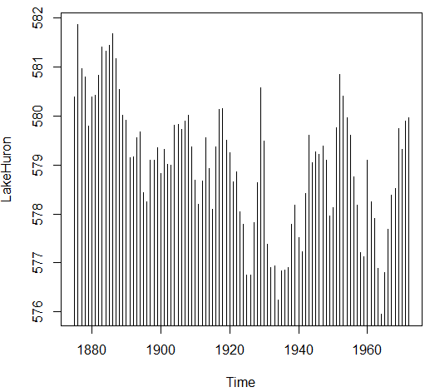
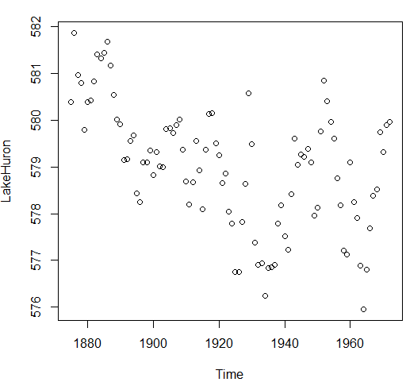
Displaying – Index Plot
The index plot is usually good for plotting data which are ordered. These are usually time series datasets, when data is measured over time.
There are 2 types of Index plots, spikes or points plots. Use the plot() function with the option type “h” or “p” respectively.
Example 3.7: Level of Lake Huron 1875 - 1972
Notes:
Example 3.7. Level of Lake Huron 1875-1972. Brockwell and Davis [11] give the annual measurements
of the level (in feet) of Lake Huron from 1875–1972. The data are stored in the time
series LakeHuron. See ?LakeHuron. Figure 3.1.4 was produced with the following code:

Slide 24
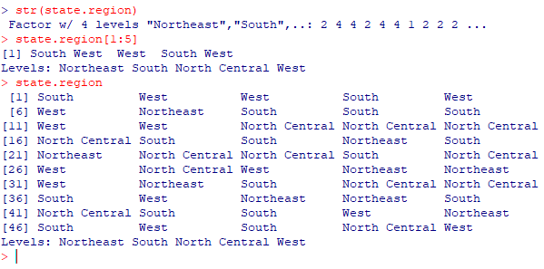
Types of Data - Qualitative Data
Qualitative data is simply any type of data that is not numerical, or does not represent numerical quantities. Eg; Name, Gender, Race/Ethnicity or Social Security Number.
Some data may seem Quantitative in nature but it’s actually qualitative. Eg; Shoe Size – if we have a shoe size 8 and 9. If we add them we do not get a size 17.
These types of variables that are qualitative nature will be used to categorize data into various sections, but does not play a role alone concerning the statistics.
There are two types of Qualitative data namely; Nominal and Ordinal.
Example 3.9: US State Facts and Features
Notes:
Example 3.9. U.S. State Facts and Features. The U.S. Department of Commerce of the U.S. Census
Bureau releases all sorts of information in the Statistical Abstract of the United States, and the state.region data lists each of the 50 states and the region to which it belongs, be it Northeast,
South, North Central, or West. See ?state.region.

Slide 25
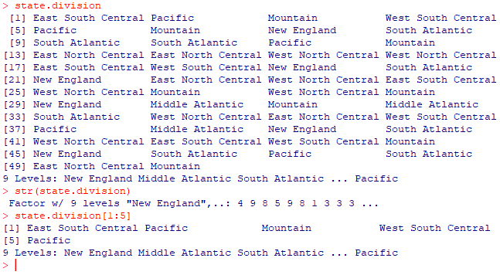
Types of Data – Qualitative cont.
Example 3.9: US State Facts and Features

Slide 26
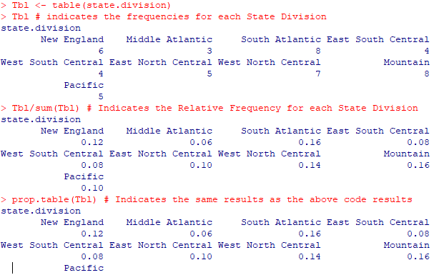
Qualitative Data
The table() function – is used to display qualitative data in the form of a table of data values.

Slide 27
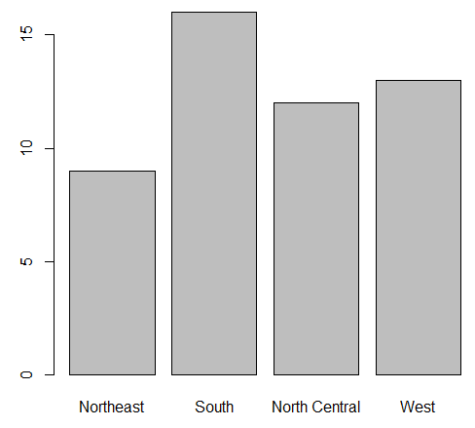
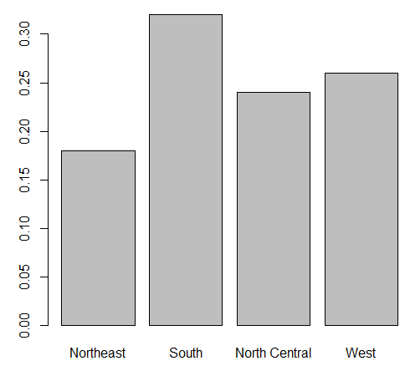
Displaying - Barplot
A bar graph is used to display categorical data, which displays each level of a specific factors, with the height of the bars being proportional to the frequencies of the observations failing in the respective categories. It will display an awkward pattern but should be interpreted as a histogram.
Example 3.10: US State Facts and Features

Slide 28
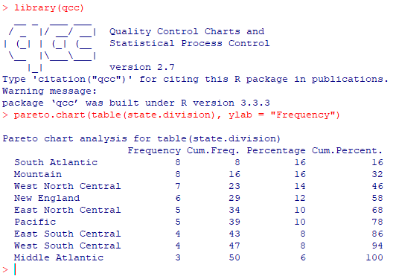
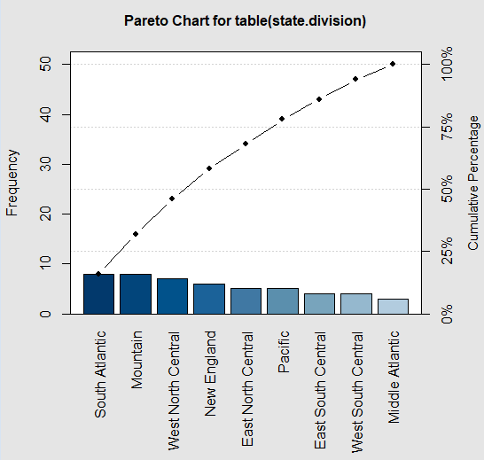
Displaying – Pareto Diagram
A Pareto Diagram is similar to a Barplot, but it displays the bars in descending order according to the height of the bars from left to right.
You might need to install the qcc package and then load it using the library() function.
Example 3.11: US State Facts and Features

Slide 29
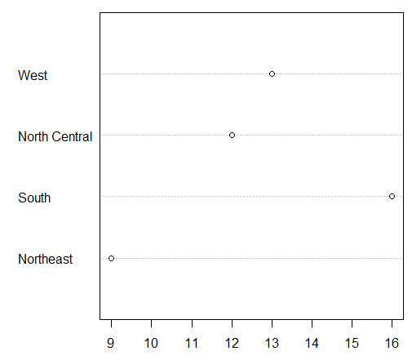

Displaying – Dot Chart
A dot plot is similar to a bar graph instead it is turned on one side with the bars replaced by dots on horizontal lines.

Slide 30


Logical Data
The value of data can either be true and false; Eg; does a person have a drivers license or not.
We have made assigned x to be a data vector from 5 to 9.
We have assigned y to indicated whether x < is less than 5, 6, 7, 8 & 9.
We can swap TRUE with FALSE with the exclamation point !.

Slide 31

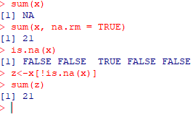
Missing Data
Missing data is a persistant problem in many statistical analyses. If we decide to calculate a summation of a continuous variable with Null values it will end up producing a results of Null summation.

Slide 32
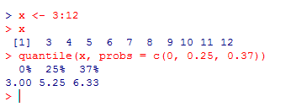
Types of Data – Features of Data Distributions
The mean of the data can be calculated using the mean() function. It is possible to calculate a trimmed mean using the trim option.
The median of the data can be calculated using the median() function.
Quantiles can be calculated using the quantile() function but sort the data first using the sort() function.

Slide 33
Measures of spread
Sample variance can be calculated using the var() function.
To calculate the sample standard deviation use the formula sd() or calculate the square root of the sample variance using the sqrt() function.
The Interquartile Range can be calculated using the IQR() function.

Slide 34


Measures of shape
To calculate skewness use the skewness() function.
The sample skewness can be any value - ∞ < g1 < ∞ . The sign of g1 indicates the direction of skewness of the distribution. Samples that have g1 > 0 indicate right-skewed distributions (or positively skewed), and samples with g1 < 0 indicate left-skewed distributions (or negatively skewed). Values of g1 near zero indicate a symmetric distribution
Kurtosis can be calculated using the kurtosis() function.
The sample excess kurtosis takes values - 2≤ g2 < ∞. The subtraction of 3 may seem mysterious but it is done so that mound shaped samples have values of g2 near zero. Samples with g2 > 0 are called leptokurtic, and samples with g2 < 0 are called platykurtic.

Slide 35
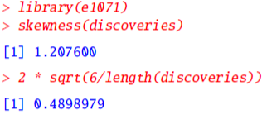
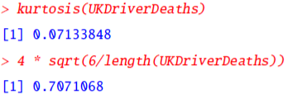
Measures of shape
Kurtosis() Function:
Skewness() Function:
As we can see the skewness of the data is slightly to the right.
The data appears to be mersokurtic
Remember to check for excess skewness and kurtosis using the formulae 3.3.6 and 3.3.7 in IPSUR.
You might need to install the qcc package and then load it using the library() function.

Slide 36
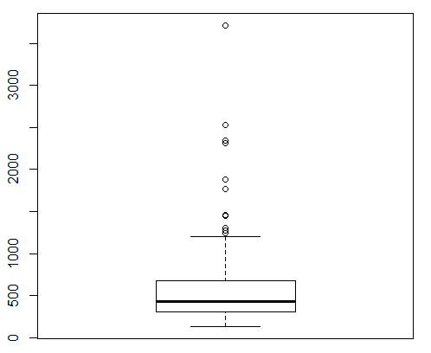
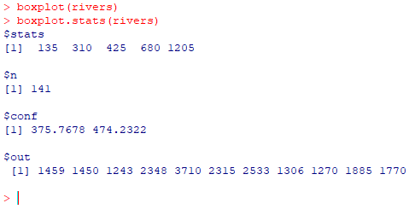
Boxplots and Outliers
To draw boxplots in R, use the boxplot() function. Outliers can be identified using the $out option with the boxplot.stats() function.

